Slide 1


Data Ethics

Slide 2
Public debate, impact, human and social factors
Philosophical foundations, science & technology ethics
Legal aspects, policy making, economics, regulation
Responsible research and innovation, diversity
Ethical AI
AI Ethics
Algorithms, architecture and interfaces
Transparency
Fairness
Justice
Inclusion
Business
Ethics
Data Ethics
It is imperative to build ethics into algorithms, otherwise AI will make unethical choices by design (Gov.au) Zhou, J. et al (2020) A survey on Ethical principles of AI and Implementations

Slide 3
Data ethics is a branch of ethics that evaluates data practices: collecting, generating, analysing and disseminating data, both structured and unstructured — that have the potential to adversely impact people and society. It includes addressing and recommending concepts of right and wrong conduct, with transparency in and defensibility of actions and decisions driven by automated/artificial intelligence (AI) in relation to data in general and personal data in particular.
https://www.cognizant.com/us/en/glossary/data-ethics

Slide 4
Why should you care about data ethics?

Slide 5
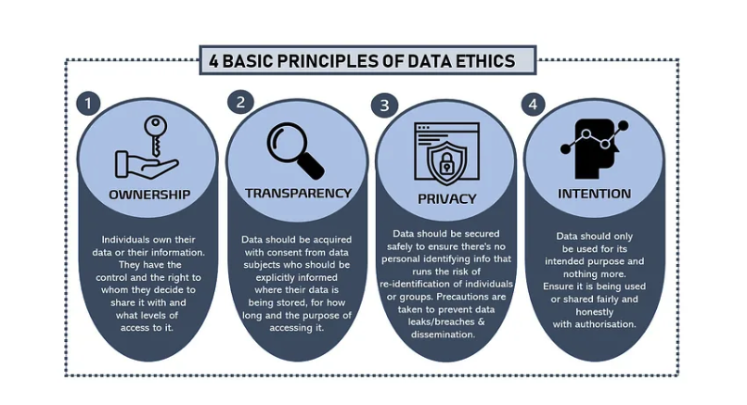
https://medium.com/@tapaita.n.kalamafoni/why-should-you-care-about-data-ethics-dbee9b85a6be

Slide 6
OWNERSHIP
Your personal information is valuable for personal use and tracking, but even more so for online businesses. Every swipe and click creates a digital trail, making it essential to protect your data, even the seemingly unimportant details.

Slide 7
2. TRANSPARENCY
Companies use targeted advertising and consumer data for profit, but there are growing concerns about unethical data handling. Data is collected in various ways—through creation, purchase, public sources, or theft. Companies must be transparent about how they obtain consent and communicate this clearly.

Slide 8
3. PRIVACY
Businesses must protect consumer data after obtaining consent to avoid security threats like data breaches. However, breaches can occur unintentionally or maliciously. For instance, in 2016, Uber was hacked, compromising 57 million users' personal information. Instead of reporting the breach, Uber paid the hackers to delete the data and covered it up for over a year, resulting in a $148 million fine.

Slide 9
4. INTENTION
Traditional ethical theories and data protection laws are often ineffective against frequent breaches. Encouraging integrity and moral choices alone cannot prevent data handlers from exploiting consumer data for personal or financial gain.
While countries have data regulations like the GDPR, these often fall short on ethical issues. Data Ethics calls for a review and update of regulatory bodies to ensure consistent accountability and better address grey areas in data privacy laws.

Slide 10
Axes of privilege
Oppression
Identity that has historically experienced more barriers/stigma
Identity is source of barriers
Identity is very present
Privilege
Identity that has historically experienced more power
Identity is source of strength
Identity seems unimportant

Slide 11

Reading exercise
Data Feminism by Catherine D’Ignazio and Lauren F. Klein
https://data-feminism.mitpress.mit.edu/
The Power Chapter
1. By whom
2. For whom
3. With whose interests and goals
Try to answer
The Problem
One example
Possible solutions

Slide 12
References
https://data-feminism.mitpress.mit.edu
https://www.codedbias.com/
https://interaktiv.br.de/ki-bewerbung/en/
https://deon.drivendata.org/examples/
https://www.slideshare.net/slideshow/dsc-adria-23-muthu-ramachandran-ai-ethics-framework-for-generative-ai-such-as-chatgpt-dsc-may-2023pptx/258138385#28

